Slide 1
Image Manipulation with Numpy
Rakshya Lama Moktan

Slide 2
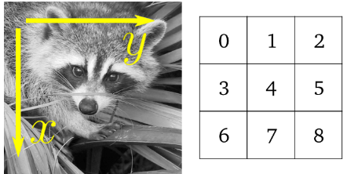
Why Numpy for Image Manipulation
NumPy provides a powerful way to work with multidimensional arrays. Images can be represented as multidimensional arrays (typically 2D for grayscale images and 3D for RGB images), allowing for easy manipulation using array operations like slicing, indexing, and arithmetic operations. They are also memory efficient and highly compatible with other libraries such as openCV, Scikit

Slide 3
Basic Operations with Numpy
Image loading and saving: NumPy can be used to load and save images in a variety of formats, such as JPEG, PNG, and TIFF.
Image resizing: Resizing an image can be done by changing the dimensions of the NumPy array.
Image cropping: Cropping an image can be done by slicing the NumPy array.
Image rotation: Rotating an image can be done by applying a rotation transformation to the NumPy array.
Image flipping: Flipping an image can be done by reflecting the NumPy array about a specified axis.
Image filtering: Image filtering can be done by applying a filter to the NumPy array. Filters can be used to blur, sharpen, or enhance images.
Image segmentation: Image segmentation is the process of dividing an image into different regions. This can be done using a variety of techniques, such as thresholding, clustering, and edge detection.
Image compression: Image compression is the process of reducing the size of an image file. This can be done using a variety of techniques, such as lossy compression and lossless compression.

Slide 4
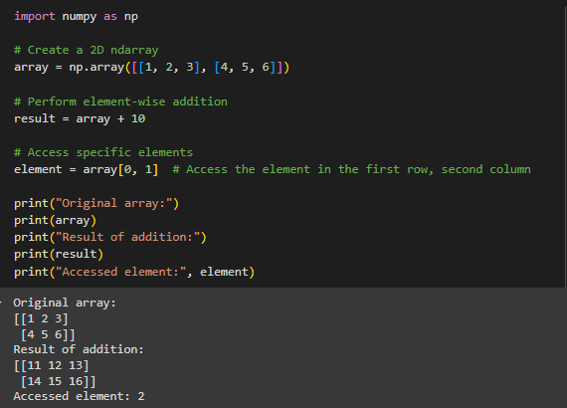
Numpy Ndarray
A numpy.ndarray (short for "n-dimensional array") is the core data structure in NumPy. It's a powerful and flexible container for large datasets of numerical data. Here are some key features and characteristics of ndarray
Multidimensional
Homogeneous Data
Efficient Storage (contiguous block of memory)
Element-wise Operations (perform on entire or slice of array)
Broadcasting

Slide 5
Broadcasting
NumPy broadcasting is a powerful feature that allows you to perform operations on arrays of different shapes in a way that makes the smaller array automatically expand to match the shape of the larger array. It simplifies operations without requiring explicit loops and can improve performance by leveraging efficient array operations.
Rules for Broadcasting:
Rule 1: If the arrays have a different number of dimensions, the shape of the smaller array is padded with ones on the left side until both shapes are the same length.
Rule 2: The sizes of the dimensions must be either the same or one of them must be 1. If the dimensions are not the same, broadcasting is not possible.

Slide 6
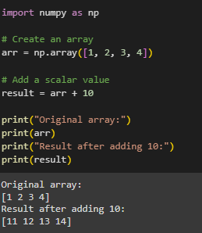
Broadcasting with a Scalar
The scalar 10 is broadcasted across each element of arr, resulting in each element being incremented by 10.

Slide 7
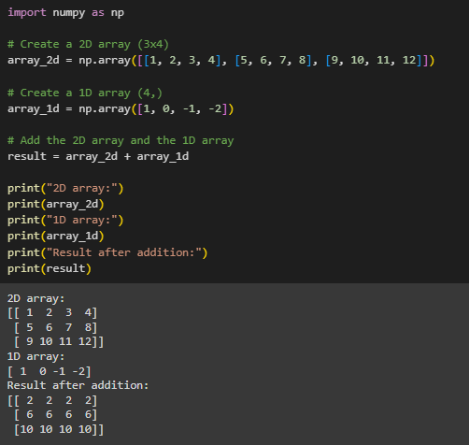
Broadcasting with Different Shapes
array_1d is broadcasted across each row of array_2d. Each element of array_1d is added to the corresponding element of each row in array_2d.

Slide 8
Why Broadcasting
No use of loops to manipulate elements in an array ( so mathematical operations are concise, simple and memory efficient)
In image → to apply mask (select only the pixel we want)

